Slide 1
Iris Dataset Classification
Debabrata Bhattacharya
12 January 2020

Slide 2
Aim of the Project
This project aims to build a model of the iris dataset. This model can be further used to classify unknown data.

Slide 3
About the Project
This is the Iris classification project. The aim of this project is to build a model that can classify the iris dataset.

Slide 4
Project Steps
Data Download
Data Loading
Data Summarization
Data Visualization
Partitioning of dataset into Training dataset and Validation dataset
Model Creation
Model Selection
Create test harness using K-Fold Cross Validation, with scoring set to 'accuracy'
Evaluation of models using test harness
Summarization, Visualization and Comparison of Results
Model Selection
Making Predictions using Selected Model
Summarization of Results
Saving the Pipelined Project
Testing the saved model

Slide 5
Project Files
Dataset
Python file (using template.py as the base)
Model files
Image files
Documentation
README.md
Project Report
Slide deck

Slide 6
About the Iris Dataset
The repository is hosted at UCI Machine Learning Repository
The data set is multivariate and contains ratio(numerical) and nominal data. There are 150 instances and 4 attributes.

Slide 7
Dataset Summarization
Shape of the dataset (instance, attribute)
(150, 5)
We can see that there are 150 instances (or rows) and 5 attributes

Slide 8
Statistical Summary
sepal-length sepal-width petal-length petal-width
count 150.000000 150.000000 150.000000 150.000000
mean 5.843333 3.054000 3.758667 1.198667
std 0.828066 0.433594 1.764420 0.763161
min 4.300000 2.000000 1.000000 0.100000
25% 5.100000 2.800000 1.600000 0.300000
50% 5.800000 3.000000 4.350000 1.300000
75% 6.400000 3.300000 5.100000 1.800000
max 7.900000 4.400000 6.900000 2.500000
From the summary we can see that the data is of 150 count. The values lie between 0 and 8.

Slide 9
Class Distribution
class
Iris-setosa = 50
Iris-versicolor = 50
Iris-virginica = 50
dtype: int64
We can see that the class distributions are well balanced, with each of the 3 classes comprising a neat third of the dataset.

Slide 10
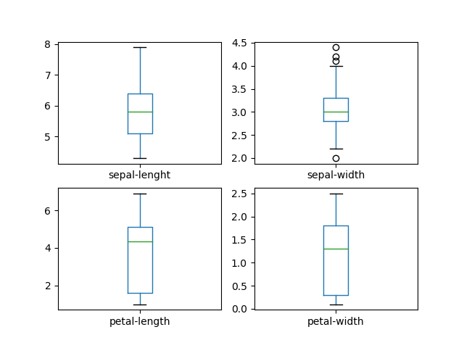
Data Visualization & analysis ____________ Box and whisker

Slide 11
Data Visualization & analysis ____________ Box and whisker
Sepal length
We can see a well-balanced dataset. There is no visible skew. The max data point seems to be well above the 75% quartile.
Sepal width
We can see some outliers here, above the max point. There is slight skew towards the 75% quartile and, the data is probably skewed to the right.
Petal length
No outliers, but the data is very much skewed towards the 25% quartile. The 75% quartile is much closer to the mean than the 25% quartile. The minimum value is quite far from the mean.
Petal width
Again, the data is very much skewed towards the 25% quartile. The minimum value is quite far from the mean.
Conclusion
Petal length and width are both on the smaller side. Values in these 2 columns are skewed to the left. Very interesting.
In contrast, sepal length and width are much more 'normal'.

Slide 12
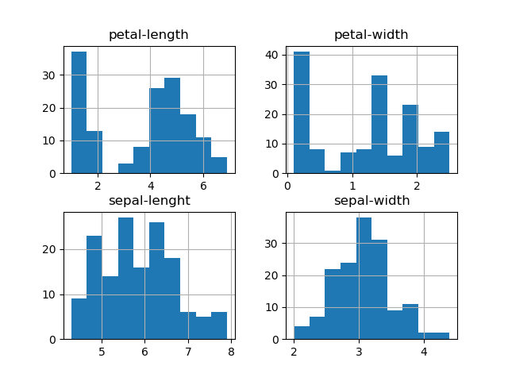
Data Visualization & analysis ____________ Histogram

Slide 13
Data Visualization & analysis ____________ Histogram
As expected, petal length and width are both heavily skewed to the left. You could draw a diagonal line from the left to the right across the Maxima of the petal width data.
Sepal length and width assume a very broken, but still imaginable bell curve.
Overall, the data seems very interesting.

Slide 14
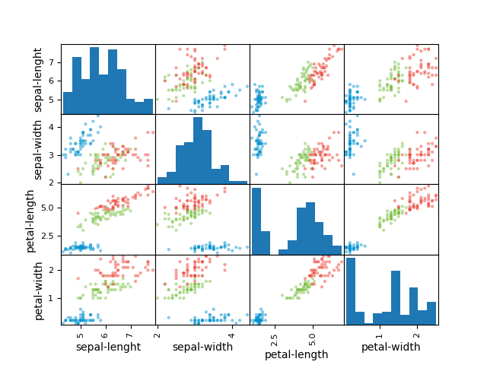
Data Visualization & analysis ____________ Scatter matrix

Slide 15
Data Visualization & analysis ____________ Scatter matrix
There's a slight correlation between sepal length and sepal width for one of the classes. This is also the case for sepal length and petal length.
Petal length and width also have a correlation for a part of the data.
Conclusion
The data has some slight correlation.

Slide 16
Model Creation
The following functions were considered to build the model:
Linear Regression
Linear Discriminant Analysis
K-Nearest Neighbors
CART
Gaussian Naïve Bayes
Support Vector Machine

Slide 17
Spot Checking
The models were spot checked on training dataset using a 10-k KFold Harness.
Results
lr: 0.9666666666666666 (0.04082482904638632)
lda: 0.975 (0.03818813079129868)
knn: 0.9833333333333332 (0.03333333333333335)
cart: 0.975 (0.03818813079129868)
nb: 0.975 (0.053359368645273735)
svm: 0.9916666666666666 (0.025000000000000012)
From the figure we can see the nearly all the non-linear models reach near 1.00 accuracy.
SVM and KNN seem to have the highest estimated accuracy scores. We have chosen the KNN.

Slide 18
Results
Accuracy = 0.9666666666666667
Classification report:
precision recall f1-score support
Iris-setosa 1.00 1.00 1.00 50
Iris-versicolor 0.96 0.94 0.95 50
Iris-virginica 0.94 0.96 0.95 50
accuracy 0.97 150
macro avg 0.97 0.97 0.97 150
weighted avg 0.97 0.97 0.97 150

Slide 19
Tests
The following things were tested:
Loading and partitioning of data
Accuracy of finalized model

Slide 20
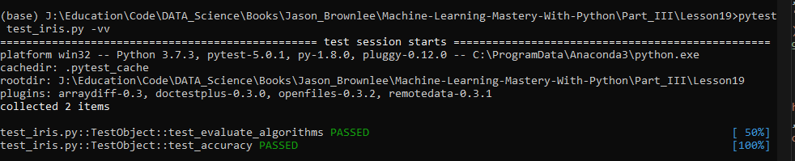
Test Results

